Slide 1
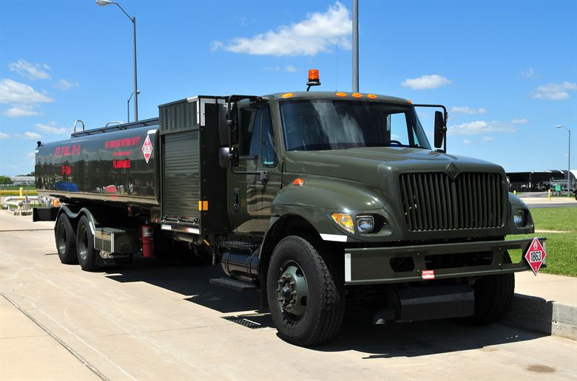
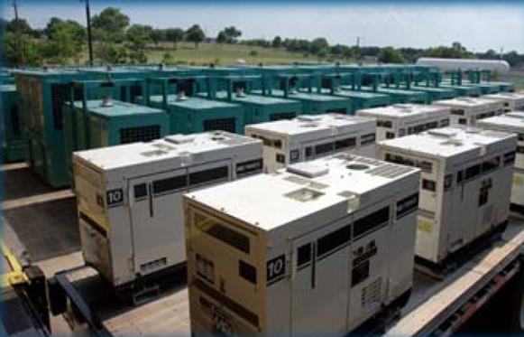
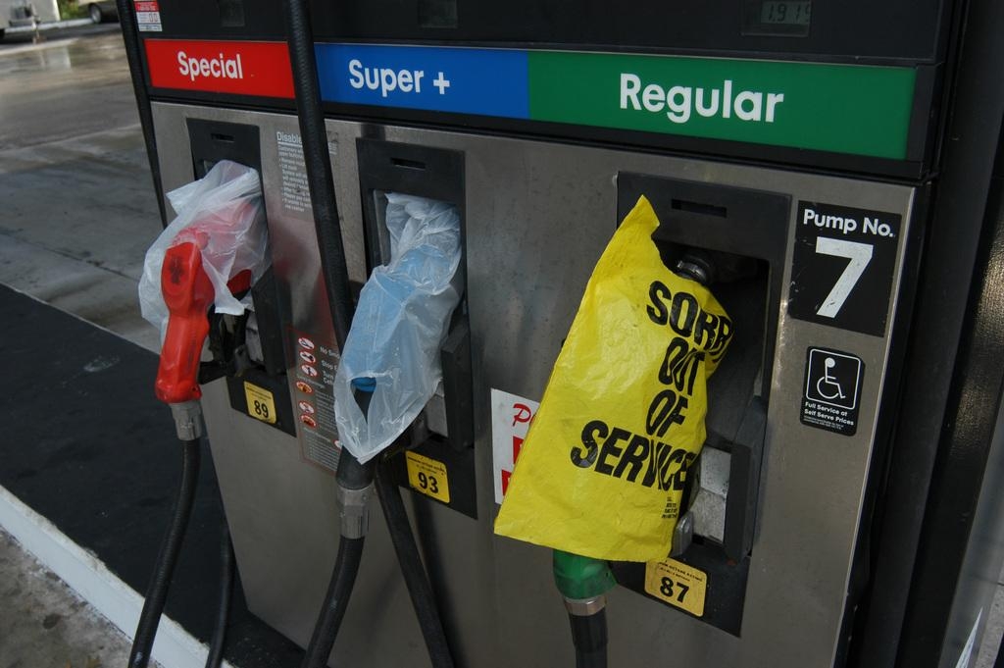
[Tribe or County} Emergency Fueling Tabletop Exercise
This material is based upon work supported by the U.S. Department of Energy’s Office of Energy Efficiency and Renewable Energy (EERE) under the Weatherization and Intergovernmental Programs Office Award Number DE-EE0008614.
[Date]

Slide 2
What is a Table Top?
Tabletop exercises are facilitated meetings where team members discuss their roles during an emergency and their responses to a particular emergency situation.
The purpose of this table top exercise is to test and validate the (Insert Community or Agency) Emergency Operation Plan.
Our goal is to better prepare for when emergencies or disasters strike.
Notes:
Facilitator Notes: Emphasise

Slide 3
Exercise Modules
Module One: Introductions and exercise ground rules
Module Two: Storm preparation and initial response
Module Three: Emergency fueling for critical services vehicles
Module Four: Emergency fueling for critical facilities

Slide 4
Module 1
Introductions and Exercise Ground Rules

Slide 5
Introductions
Name
Organization
Role in organization
Role in disaster response

Slide 6
Participant Roles
Players: Respond to situation presented based on current plans, policies, and procedures
Observers: Support players in developing responses, but do not participate in moderated discussion
Facilitators: Provide situation updates and moderate the discussion
Evaluators: Observe and document player discussions
All participants: Please fill out exercise evaluation forms throughout the exercise

Slide 7
The Game Plan
Turn cell to vibrate or off.
Only one person speak at a time.
Respect other players opinions.
Please limit sidebar conversations.
Contribute to the discussion
Mute microphone if presenting virtually
Enjoy the exercise and learn!

Slide 8
Exercise Conduct
The exercise is conducted in a no-fault learning environment wherein capabilities, plans, systems, and processes will be evaluated
The exercise scenario is plausible, and events occur as they are presented

Slide 9
Exercise Schedule
[Insert Facility Diagram and Highlight restrooms and emergency exits]
Delete blue box if no diagram available.
0900 – Welcome and introductions
0910 – Exercise overview
0915 - Tabletop Discussion
1015 – Break (10 Minutes)
1025 – Resume Discussion
1130 – Hot wash
1200 – ENDEX

Slide 10
Core Capabilities & Objectives
Exercise Objectives | Core Capability
1. Evaluate [tribal or county] emergency operations plans and procedures as they relate to ESF-12 Energy | Planning
2. Discuss how an energy shortage [propane, electrical outage, diesel/gas shortage] changes your established logistics and critical resource procurement. | Logistics and Supply Chain Management
3. Identify how your [tribe or county] defines critical services in an emergency (Example: points of distribution, fueling first responders, critical care facilities, and generators) | Logistics and Supply Chain Management
4. Discuss and analyze the transportation, tracking, and management of resources and associated costs | Logistics and Supply Chain Management
5. Discuss your command structure for this scenario | Operational Coordination
Notes:
Add Operational Coordination – Management of the Incident

Slide 11
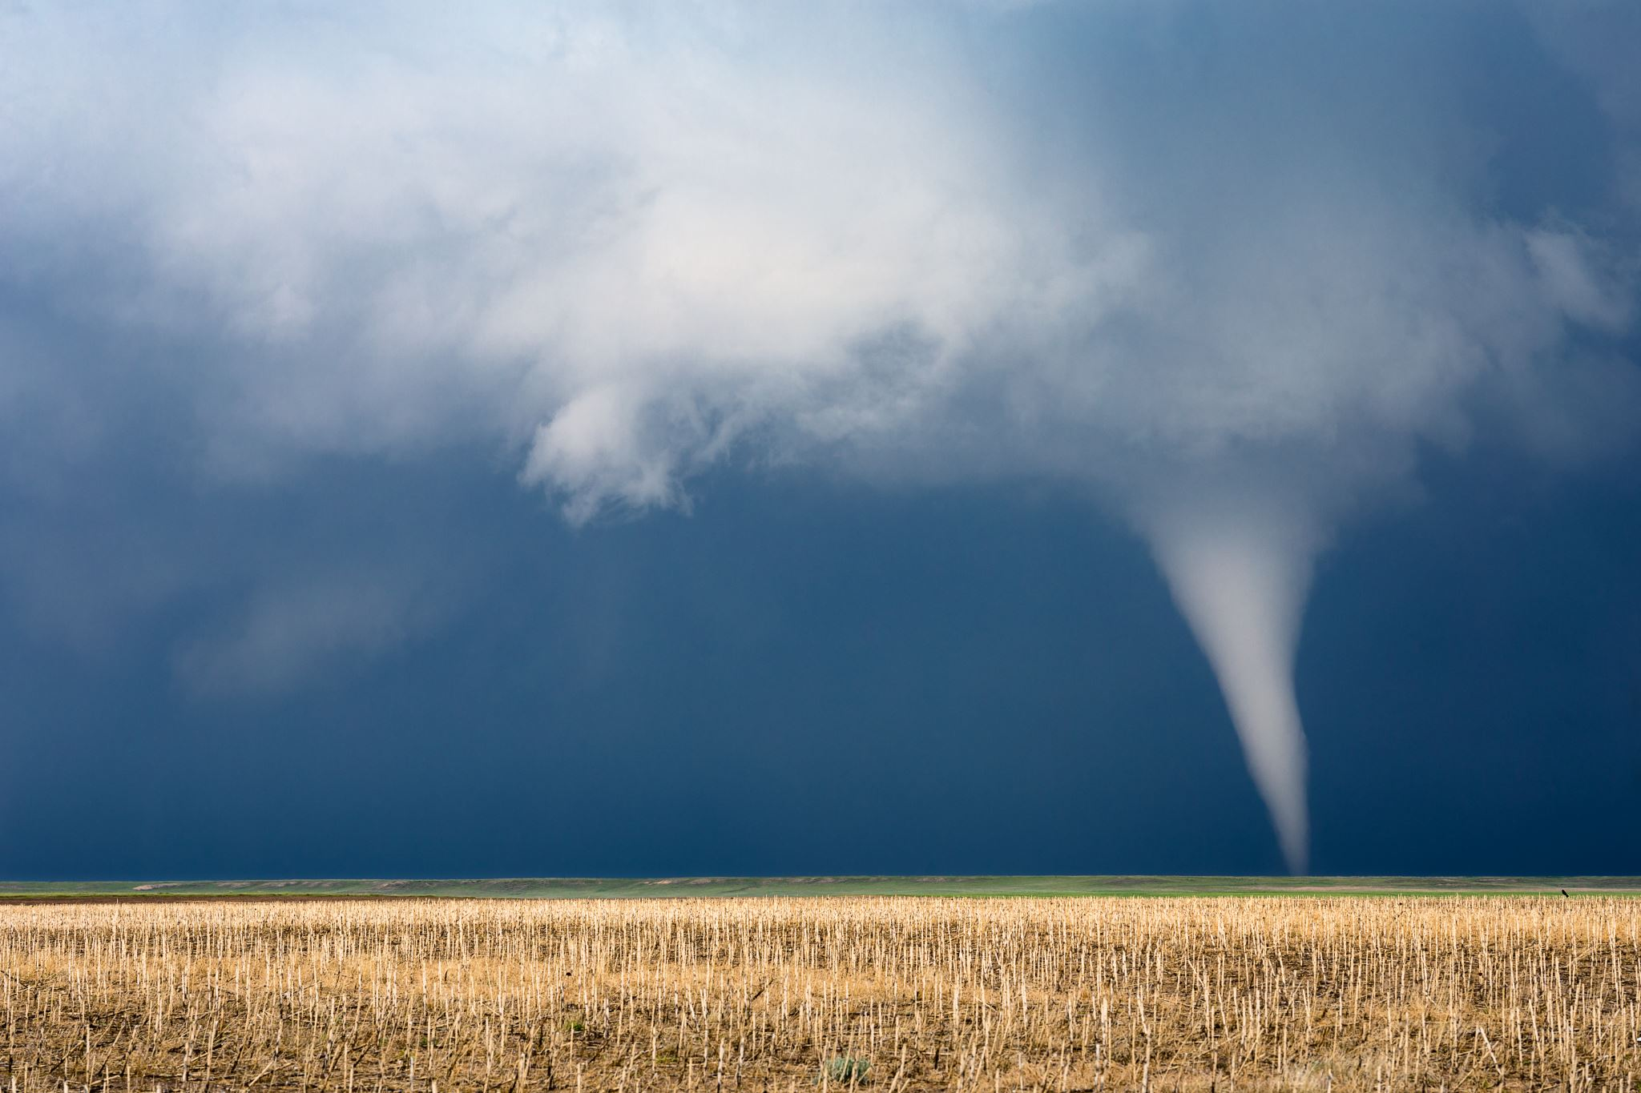
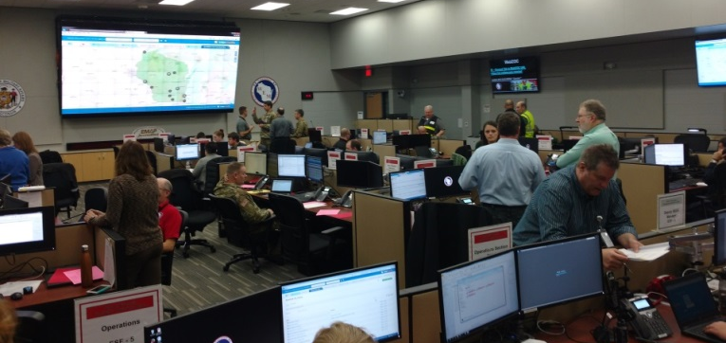
Module 2
Storm Preparation and Initial Response

Slide 12
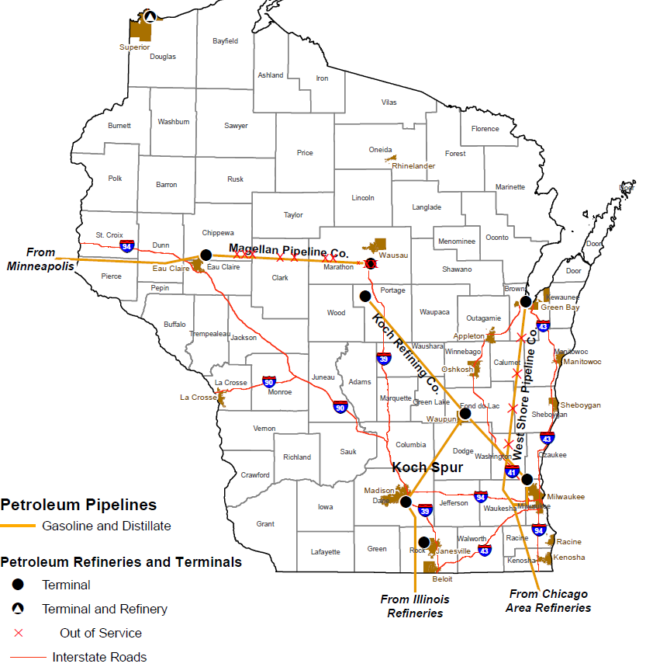
Scenario Background
Wisconsin has three refined produce pipelines
Wisconsin has one refinery (Superior WI)
There are about 10 major fuel terminals in the state
The vast majority of commercial gas stations in Wisconsin do NOT have backup generators on-site

Slide 13
Exercise Scenario Background
Background: It is the first Friday in August. Daytime temperatures throughout Wisconsin have hovered around 100 degrees, and the National Weather Service issued heat advisories for most of the state, including [insert tribe or county]
At 10:00AM, the National Weather Service hosted a statewide webinar to brief emergency managers about the strong chance for severe weather and tornados as cold front passes through the state around 6-9pm tonight. A tornado watch is later issued for multiple areas of the state including [insert tribe or county] through 9pm.
This Photo by Unknown Author is licensed under CC BY-NC
https://youtu.be/dux5oPAJ1jM

Slide 14
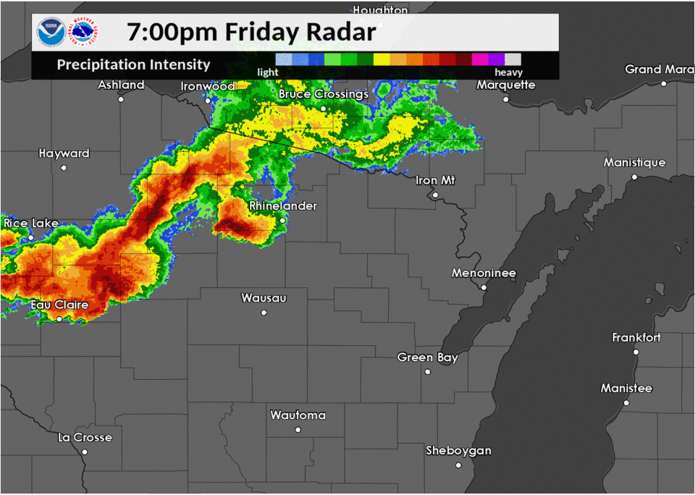
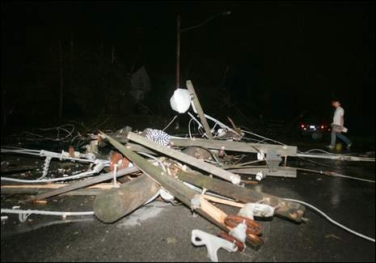
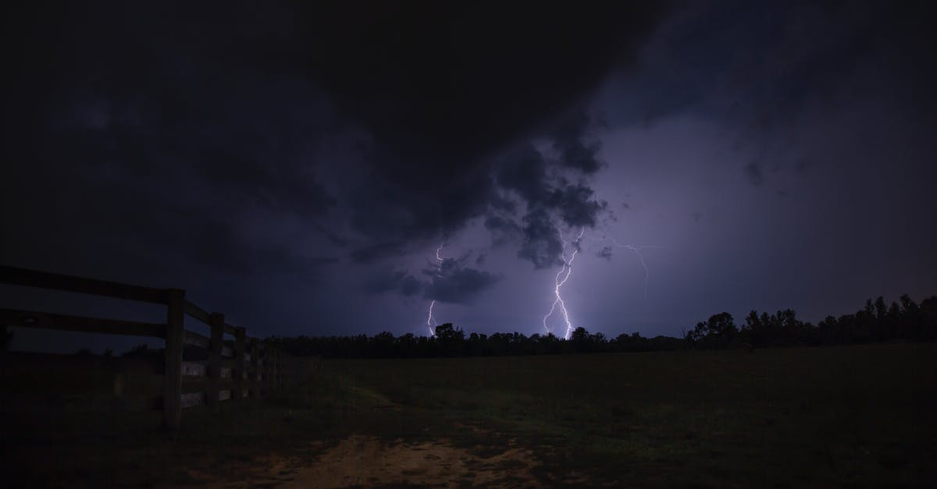
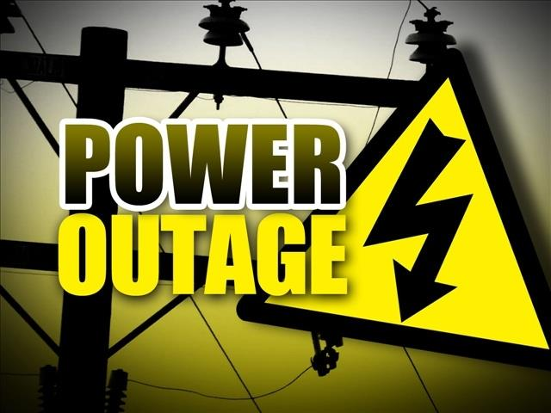
Scenario Continued
By 9PM, a line of severe storms has moved through the [insert region] of the state. 16 tornados of varying strength were either observed or detected by radar as the storms went through. Additionally, there are reports that sustained winds reached 85 – 90 mph in some areas.
The storms have caused a widespread power outage in the [insert region] of Wisconsin. Downed power lines, trees, and other debris are reported along roadways. Cellular service is available.
There are reports of multiple damages structures throughout the region.
July 19th, 2019 Radar Images
This Photo by Unknown Author is licensed under CC BY-NC-ND
This Photo by Unknown Author is licensed under CC BY-ND
Notes:
With the power out, how do you find out about the extent of the damage?
What initial steps would Emergency Management take in this scenario?
EOC Activation?
Emergency Declaration?
Who has this authority?
Can you communicate with this authority during a power outage?
What if cellular networks were damaged?
What does an emergency declaration do for your jurisdiction in terms of opening up resources during a disaster?
Who are you bringing to your EOC for this response?
Does your EOC have backup power generators? How long can they operate for without fueling? Are there other facilities you plan to use as an ICP or EOC if the EOC is not functional?
How do you determine where damage is throughout your jurisdiction? When does this process start?
How do you determine where the power is out in your jurisdiction?
Do you have a local utility contact for each utility that provides power to your jurisdiction?
What are utilities doing at this point to assess the situation? (ask if utilities are participating)
How is this incident managed? (ICS Structure, EOC, Etc.)

Slide 15
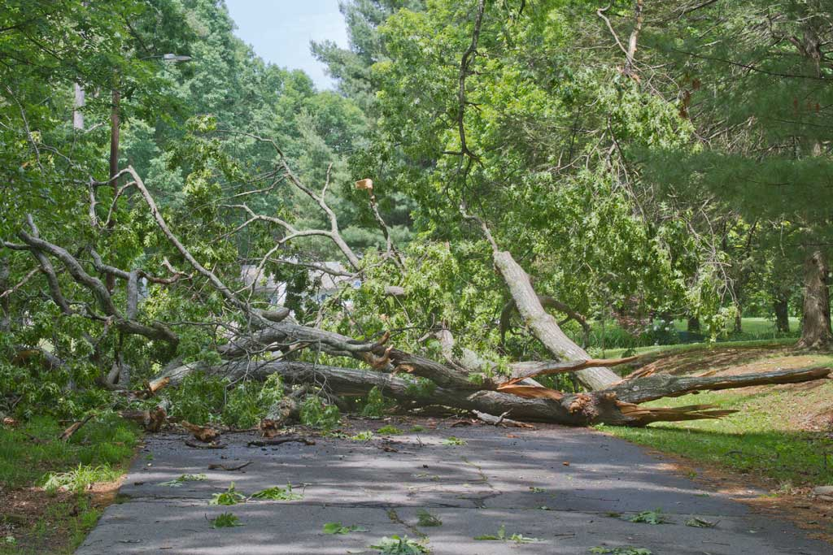
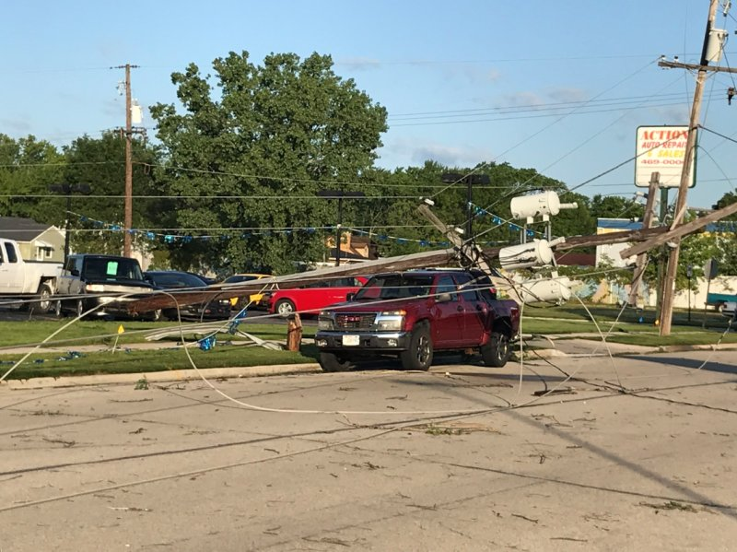
Scenario Continued – Next Day
Daylight reveals widespread wind damage. Debris and downed trees and power lines cover several roadways within [insert county or tribe] and similar situations exist throughout the region.
The State Emergency Operations Center (SEOC) has opened to a Level 2.
Utilities are unable to access many areas and can’t provide accurate restoration timelines. Initial estimates are around 1 week in many areas.
Most fuel stations in the region, including neighboring counties, are unable to pump fuel due to the power outage. Critical sites throughout the region are running on generator power.
This Photo by Unknown Author is licensed under CC BY-NC-ND
Notes:
What are your first priorities in this situation?
How does the initial estimate of 1 week without power change your response?
What are your initial concerns upon hearing that number?
What key facilities in your jurisdiction have backup generators? Do you know what types? How long they can run for? (Water treatment facilities, EOCs, fire departments, PSAPs, cellular towers, radio towers, hospitals, etc.)
Who is responsible for acquiring fuel for your EOC facility’s generator?
Who has the authority to “activate” your energy emergency response plan?
Do you coordinate with electric utilities to determine if they need assistance?
Do you communicate priorities for restoration with utilities? If your learned of an urgent matter, how would you do so?
Do you know of gas stations within your area that have backup generators?
Do your jurisdictions vehicle fleets (or other local government entities within your jurisdiction) rely on commercial gas stations for fueling?
Do your highway shops have backup generators?
How do fuel vendors operate in a situation like this (ask directly to vendors if participating)
Do you have the ability to pump fuel without power?
What emergency plans do you have to provide fuel to customers in the event of a widespread power outage?
Would you work with other vendors to supply your customers if you couldn’t? Is that up to the customers?
What information might you need from local authorities in order to operate in these conditions?

Slide 16
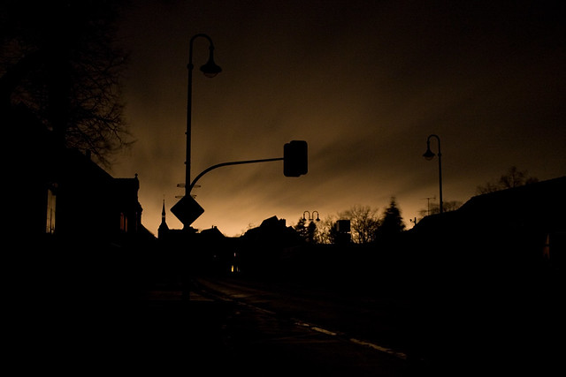
Module 3
This Photo by Unknown Author is licensed under CC BY
Long Term Power Outage Response and Emergency Fueling

Slide 17
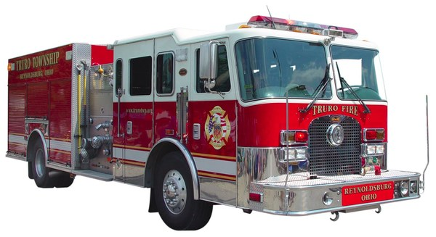
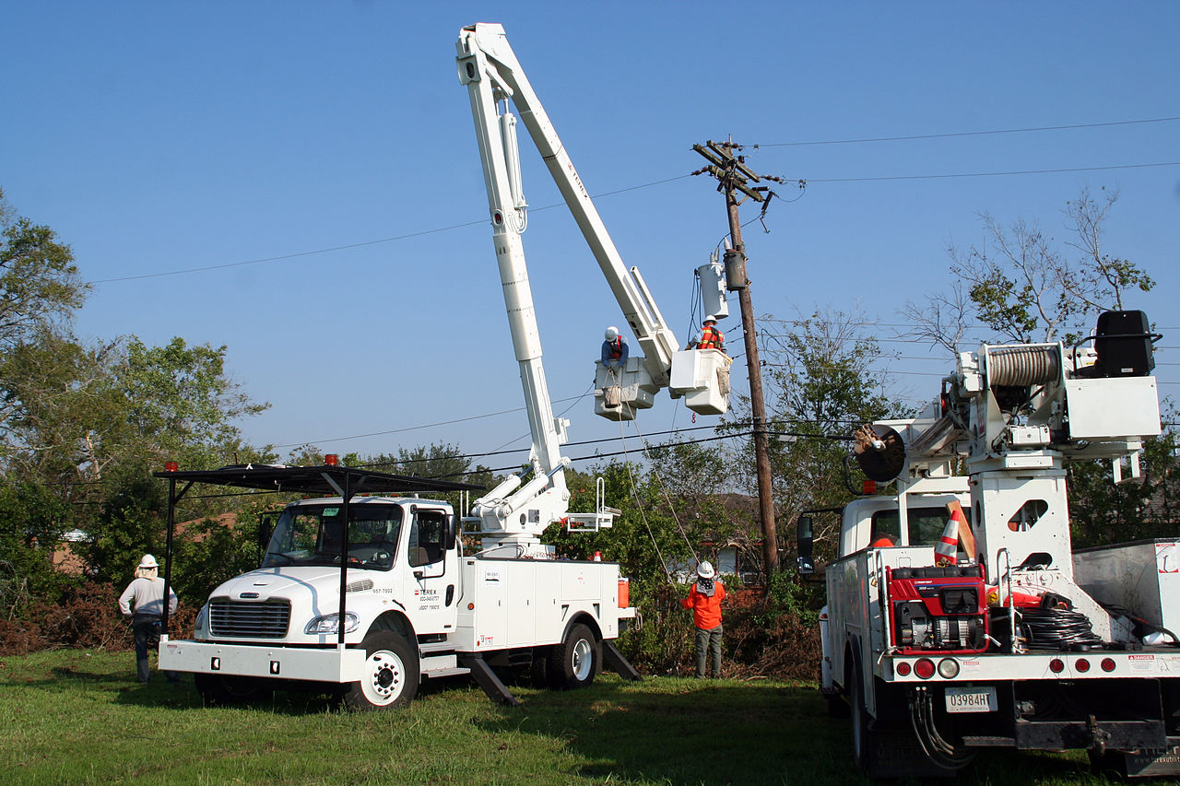
Scenario Update – 48 Hours After Storm
Power is still down across the region. Isolated areas may see restoration within 12 hours. Most will remain without power for up to 3-5 more days.
Local fire and police departments are requesting both diesel and gasoline to continue operations as they have been unable to fuel at gas stations in [insert tribe or county] or nearby counties.
Some fuel vendors have been unable to resupply facility generators due to the power outage and inability to access sites. Several facilities have contacted your EOC and are requesting assistance with obtaining fuel.
Electric utilities have significant mutual aid resources on-scene clearing debris, ensuring lines are de-energized, and repairing power infrastructure.
Volunteer agencies are sending volunteers to help clear debris and establish shelters, and are asking your EOC where they can obtain fuel.
This Photo by Unknown Author is licensed under CC BY-ND
This Photo by Unknown Author is licensed under CC BY-SA
Notes:
Is it feasible to travel outside the outage area to obtain fuel if multiple counties away? (ask to LE & Fire)
Do local government entities know how to request fuel through the EOC? What information is needed? Is there a standard form or set of questions?
Do you prioritize response to critical facilities for fuel resupply? If their vendor can’t deliver, what can your jurisdiction do to assist? Do you have a list of other vendors in your area?
What questions do you ask of a facility when they are in need of fuel?
When would you request fuel assistance from the State EOC? How do you request this type of assistance?
How are fuel vendors handling a situation like this? (ask if fuel vendors are participating).
Where are your operations coordinated out of?
How do fuel vendors decide which customers to refuel first in a situation like this?
Given the restoration times above, would you activate your plans associated with emergency fueling?
Is there staffing involved
How does that activation occur?
What would you do if a facility requested fuel? What if multiple request fuel? Who do you take care of first? How do you determine that?
How does payment work at these sites when power is not working?
If state or federal law enforcement need fuel, can they get it at the [INSERT COUNTY OR TRIBE] fuel sites?
If so, how is payment tracked?
Are other responding agencies and organizations allowed to get fuel at these sites? Utility line crews? Telecommunications companies? ESF 12 mentions temporary accounts, how is this set up? How long does it take to set up?
If the state declares an emergency and initiates a “priority end-user” program, does this impact who has access to the fuel sites established by your jurisdiction?
How do you determine who gets access to fuel at your distribution sites?
Do you set up mobile or fixed fuel points?

Slide 18
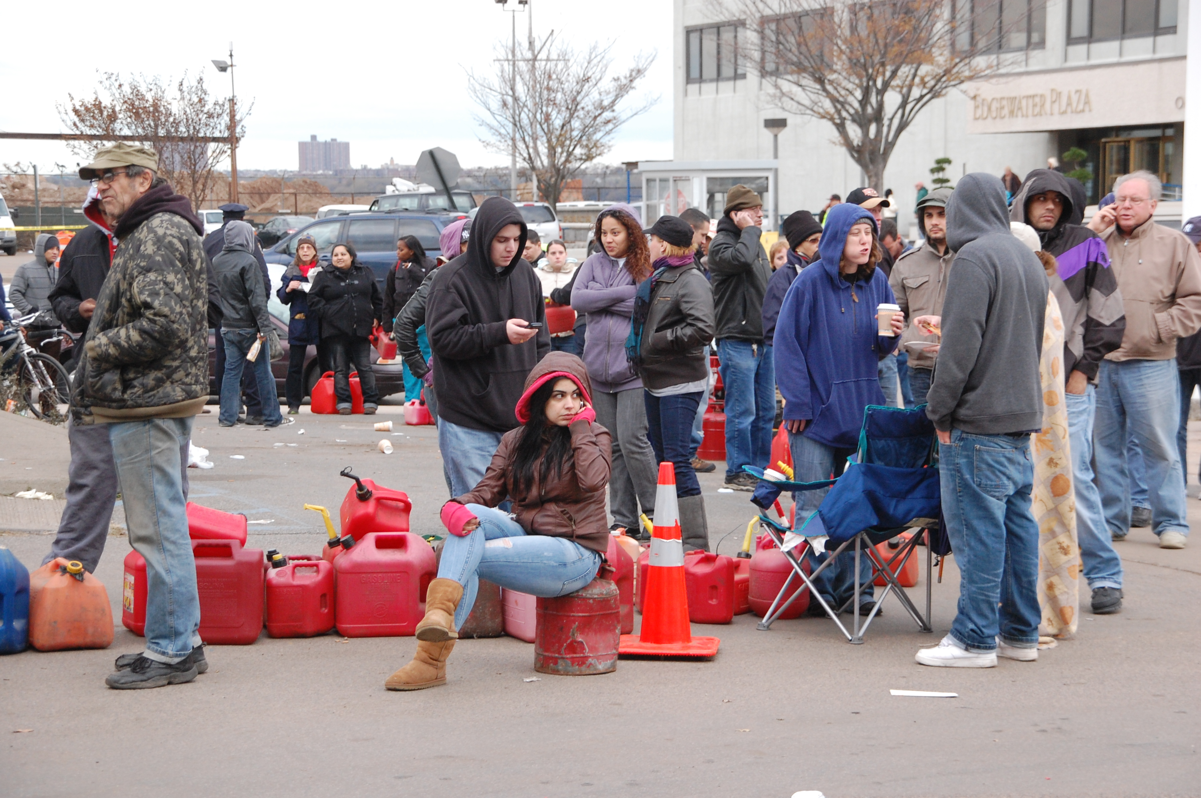
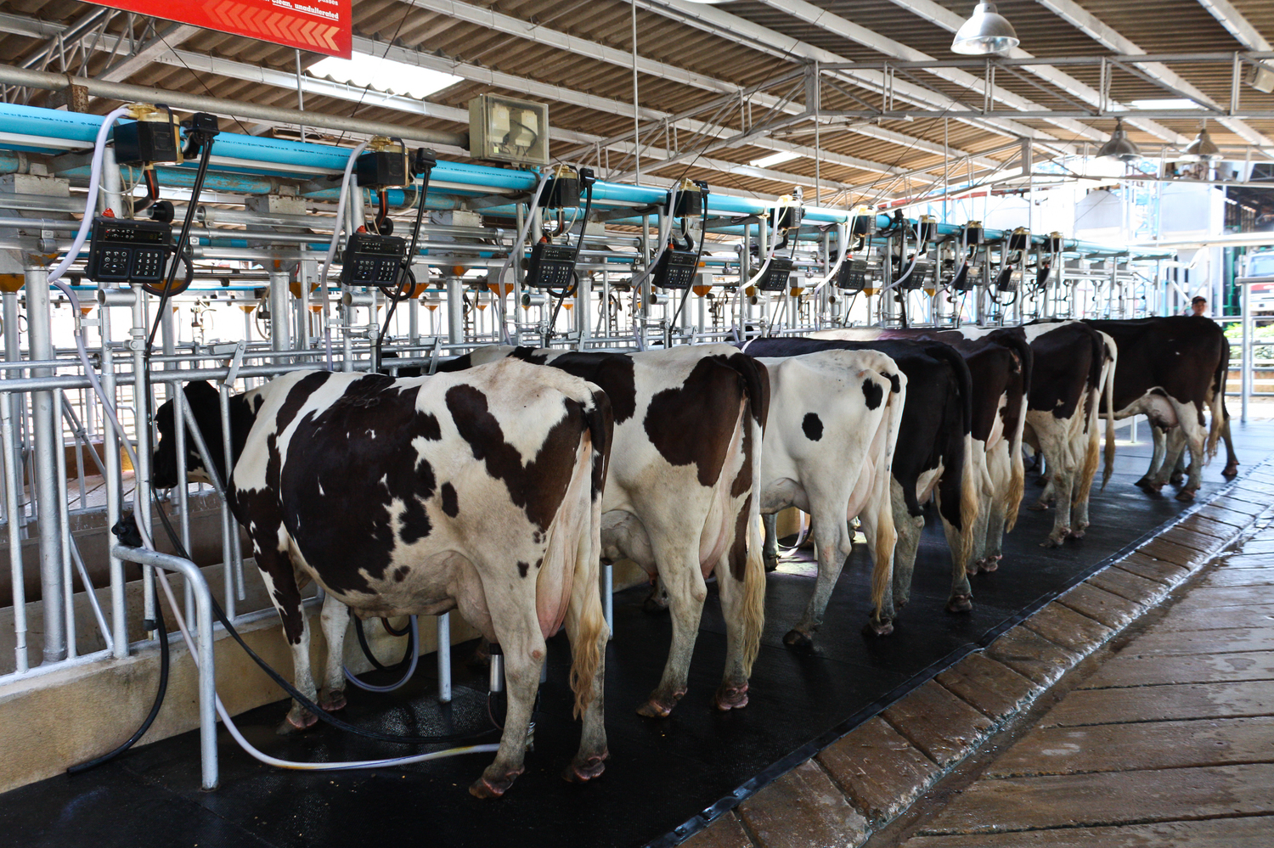
Final Scenario Update – 72-96 Hours After Storm
Power has been restored to about a third of the region, but many towns remain without power.
Several dairy farmers are running low on diesel fuel and have asked for assistance with resupply as power has not been restored in their areas yet.
Rumors of a fuel shortage have spread on social media causing increased demand and lines at re-opening gas stations.
Utilities estimate power will be fully restored in [insert tribe or county] in 3-4 days (approximately 8 days after storm).
This Photo by Unknown Author is licensed under CC BY-ND
This Photo by Unknown Author is licensed under CC BY-SA-NC
Notes:
What messaging would you send to the public regarding the fuel situation? How would you deliver that message in areas where power is out?
How would you prioritize a dairy farm’s fuel needs against a cellular service providers or wastewater treatment facility? If someone were to ask you what methodology you utilized, would you have an answer?
If the county purchases fuel for the emergency, can it be reimbursed later? What documentation is needed?
What messaging is needed when you close fuel points of distribution?

Slide 19
Module 4
Exercise Hotwash

Slide 20
Exercise Hotwash
Strengths
Areas for Improvement
Training
Planning
Staffing/Equipment

